Slide 1


METRO SIGNALLING SYSTEM
Harmony in motion : Revolutionizing Urban Transport with Metro Signalling Symphony
BY:
Arahanth M
Bolt Iot and ML training student

Slide 2
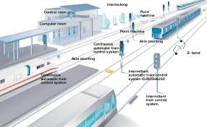
ACKNOWLEDGEMENT
Hello Everyone , My name is Arahanth M. I’m currently pursuing my B.tech degree from R V College of Engineering ,Bangalore , Karnataka.
I am very glad and grateful for both the institution in which I’m studying and the BOLT team for giving me such a wonderful opportunity to showcase the ideas that I have regarding Internet of Things and Machine Learning.
I have put in my 100% in building this particular project and have done a lot of research regarding metro signalling system which I will share abou tin the later part of this presentation.

Slide 3
CONTENTS
I have decided to break this presentation into four major parts:
1.Introduction to the topic and reasons for choosing this .
2.Expalnation about the software part of my project
3.Detail explanation regarding the hardware equipment and connections.
4.Working of my model and sharing my experience during the course of the project.

Slide 4
SOFTWARE PART
In this project, I have tried to build a simulation of metro signalling system using Arduino and bolt module.
I have tried to develop my own code that works on the logic and interconnected sensors to receive and transmit data.
This model is based on signals-Red ,Yellow and Green.
It also sends messages to the drivers mobile phones regarding the status of the train, its position and distance between the two trains.
Now I am going to explain the Arduino code I have used in my project.

Slide 5
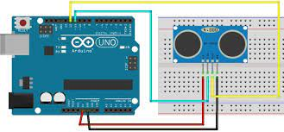
HARDWARE COMPONENTS AND CONECTIONS.
The various components that I have used in my project are:
1.Arduino UNO
2.Bolt WIFI module
3.Bread Board
4. Ultrasonic Sensor(x3)
5.LED(2 sets of RGB )
6.Jumper wires

Slide 6
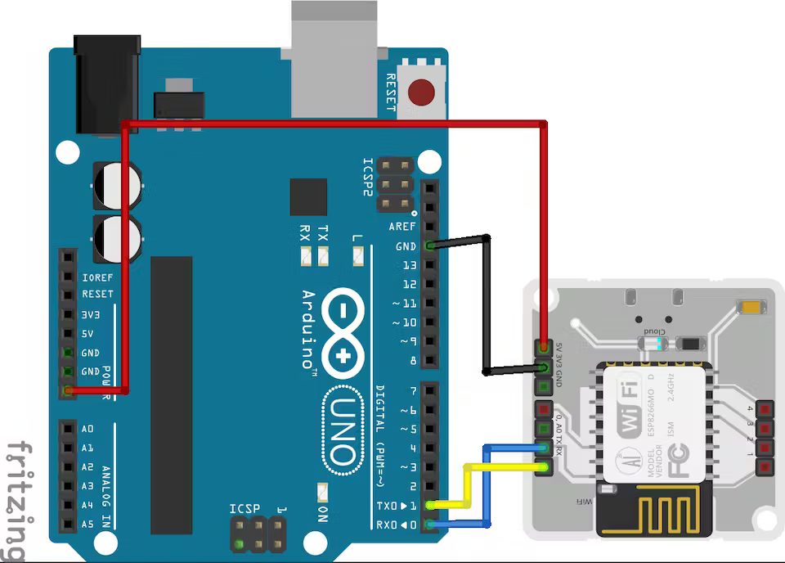
Arduino AND Bolt Together…
I interconnected the Arduino and Bolt module together to receive data from sensors and plot graphs on bolt cloud
With the help of bolt module, I was able to send SMS to the mobile numbers.
The connection of bolt with Arduino is as follows:

Slide 7
Continued…
in order to link Arduino with bolt , you need to download some libraries from GitHub into your Arduino IDE
Go through the following ink to learn better
https://docs.boltiot.com/docs/arduino-library
https://docs.boltiot.com/docs/serial-begin
https://docs.boltiot.com/docs/send-serial-data-output
https://docs.boltiot.com/docs/write-and-then-read-serial-data
Now I am going to show you the connections of ultrasonic sensor with Arduino board.

Slide 8
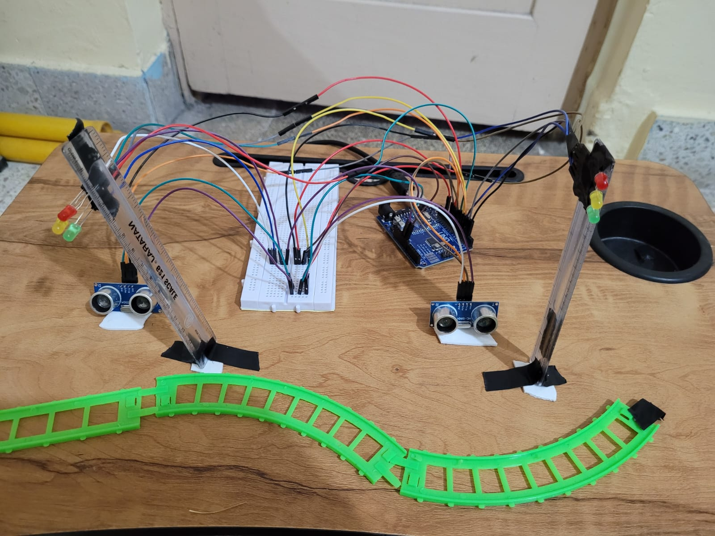
DEMONSTRATION
Now I will show you the demonstration of my model.
This gives you a clear understanding about the model.

Slide 9
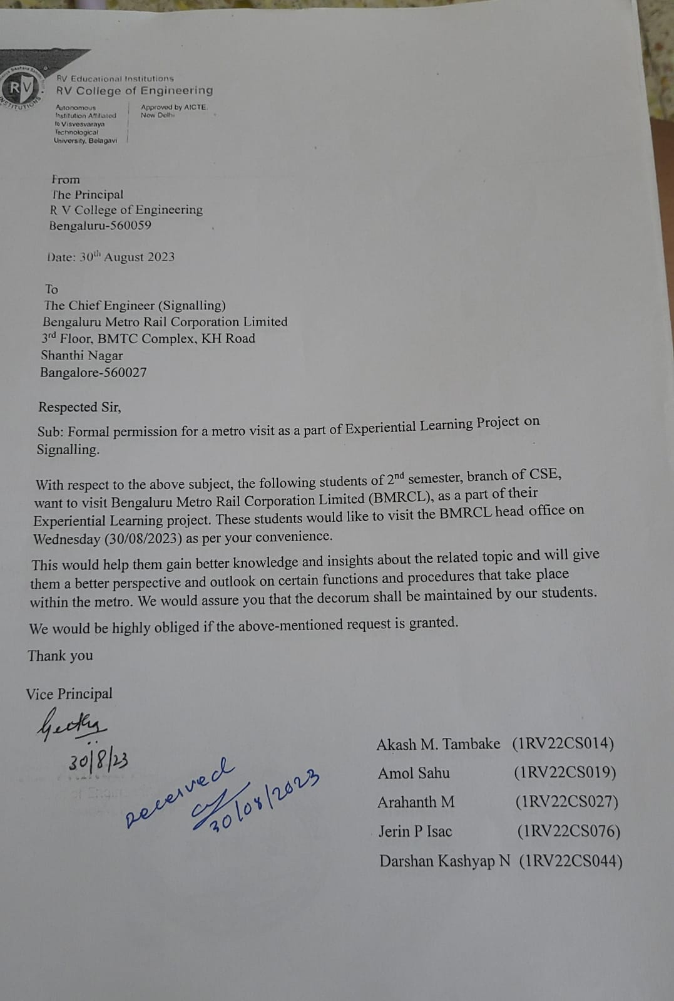
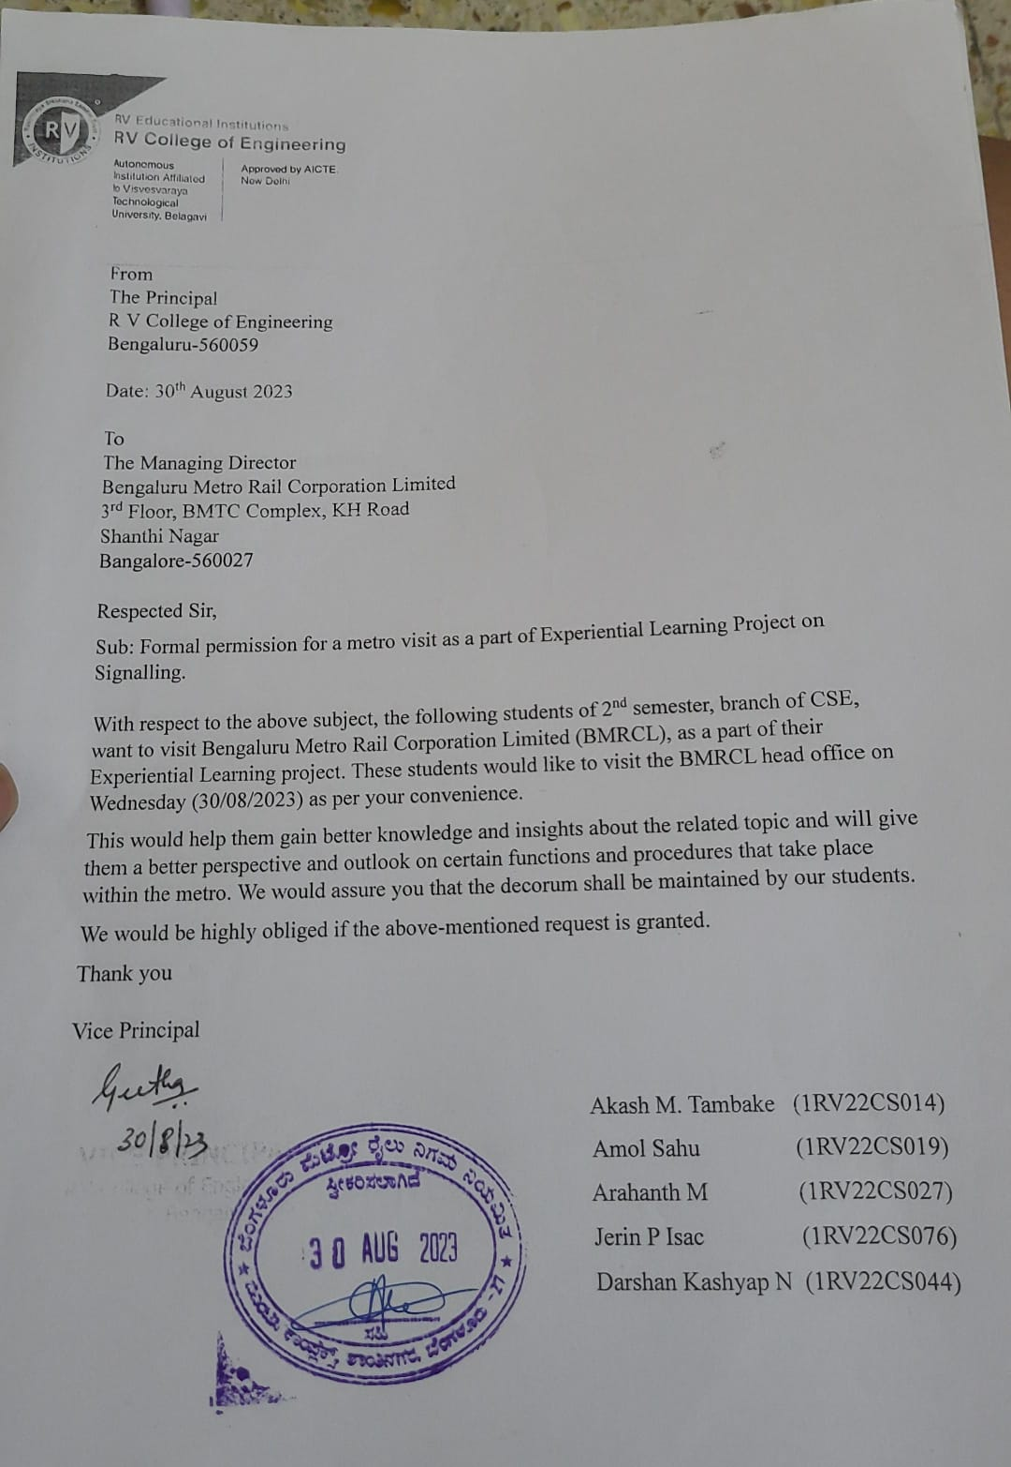
BMRCL Visit As A part of Research
I was lucky enough to visit the head office of Bangalore Metro.
Thanks to college and of course BOLT team to express my knowledge
I gained knowledge regarding the various signalling system used and the technologies used in the current urban world.

